Slide 1

The Great Audio Race
Created by: That1Group
Designed by: Brandon Scott, Andrew Rauh, Andrew Lees, Taran Pennebacker

Slide 2
Agenda
About the game.
Relevance to the topic.
Status of game.
Closing remarks.

Slide 3
Basic Game Description
Racing through space.
Implementation of music.
Movements of user within game.
Positioning of obstacles in levels.
Earning of points for the user.
INSERT GRAPHAX

Slide 4
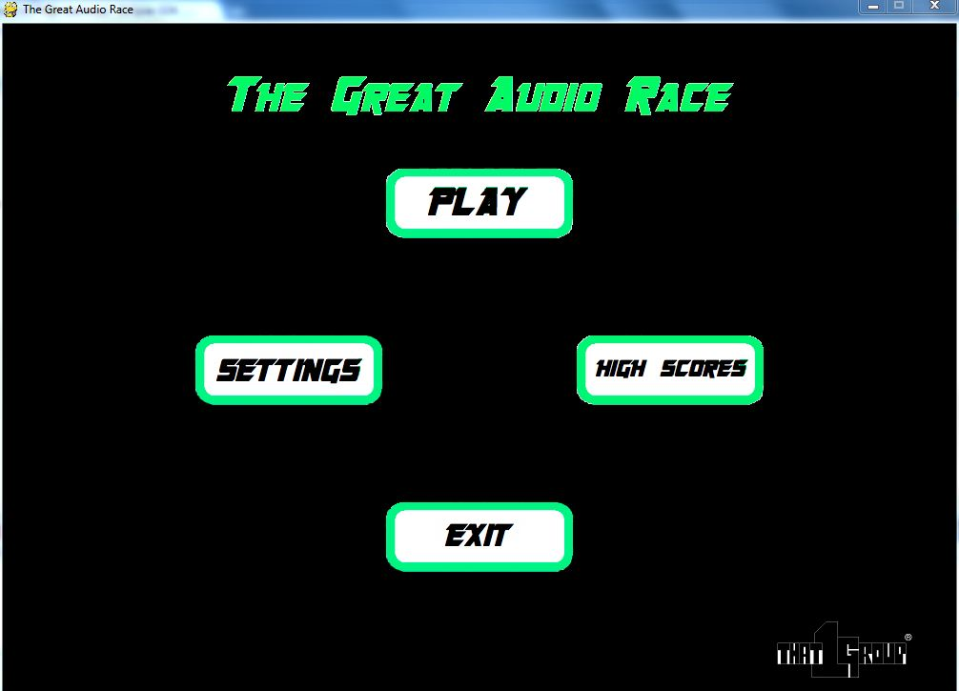
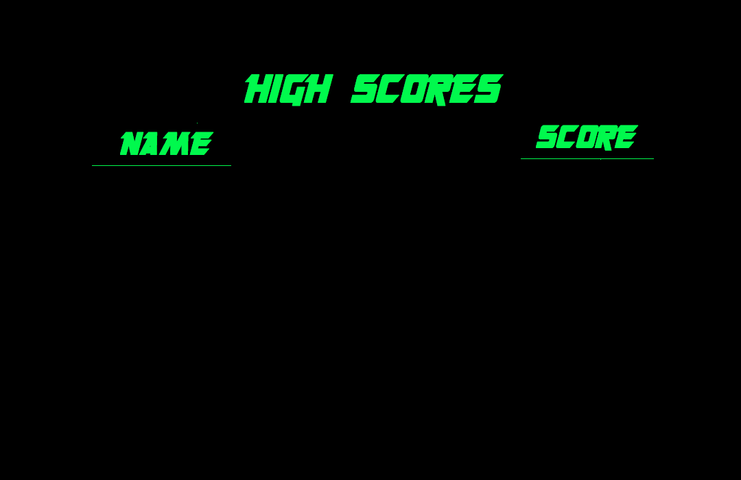
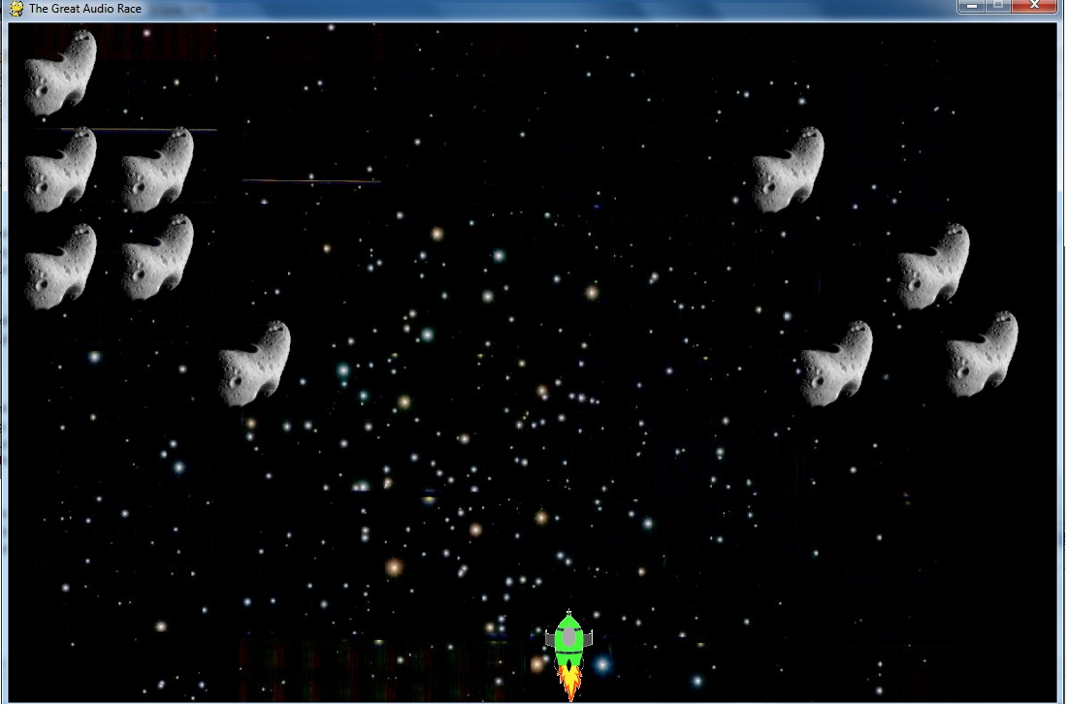

Slide 5
Main Algorithm - Math
Fourier Transform
∫f(t)cos(ωt) dt
Fourier Windowing
∫f(t)cos(ωt)*e^{-(t-to)/(s^2)} dt
Fast Fourier Transform
∫f(t)cos(ωt)*e^{-(t-to)/(s^2)} * cos(ωt)dt

Slide 6
Code Behind the Game
Collision with a group of sprites.
Creation of multiple difficulty levels.
Generate obstacles based on frequency.
Implementation of the algorithm.

Slide 7
Graphics
Use of Autocad for sprite creation.
Use of Seashore for image editing.
Use of GIMP to finalize images.

Slide 8
Relevance to Autism Spectrum Disorder (ASD)
User motion control and reaction to obstacles.
User ability to react to multiple stimuli.
User reaction to change in frequency of sound.

Slide 9
Tasks
Collect data and analyze frequency.
Create initial game menus.
Map sprites to respond to input.
Create skeleton of first few levels.
Have basic collision detection.
Add major features.
Debug code by testing.

Slide 10
Gantt Chart

Slide 11
Tasks Completed
Create initial game menus and windows.
Map sprites to respond to input.
Have basic collision detection.

Slide 12
Tasks Remaining
Collect data and analyze frequency.
Have sprite respond to user input.
Finish and finalize user interfaces.
Create skeleton of levels.
Implement advanced music selection.
Debug and clean up code.

Slide 13
Conclusion
Where our progress is overall.
When our estimated time of finish is.
What could be our possible difficulties.
Why The Great Audio Race will succeed.

Slide 14
Contact Information
The Great Audio Race Team:
Brandon Scott
Email: bjpscott@umich.edu
Phone: 517-227-6662
Twitter: BrandonJPScott
Andrew Rauh
Email: arauh@umich.edu
Phone: 313-300-1749
Twitter: a_j_r
Taran Pennebacker
Email: pennetar@umich.edu
Phone: 941-224-8130
Twitter: TaranItUpp
Andrew Lees
Email: amlees@umich.edu
Phone: 734-834-2720
Twitter: N/A

